Slide 1
Jeanne Clery Disclosure of Campus Security Policy and Campus Crime Statistics Act
Campus Security Authority Training
July 2020

Slide 2
Throughout this presentation the College of the Desert Public Safety Department will be referred to as CODPSD.
Local law enforcement agencies referred to as having jurisdiction wherein College of the Desert has properties may refer to: Riverside County Sheriff’s Department “RSD”, Palm Springs Police Department “PSPD”, Indio Police Department “IPD”, Cathedral City Police Department “CCPD”, Desert Hot Springs Police Department “DHSPD”.
The Annual Security Report may also be referred to as ASR.

Slide 3
Expected Outcomes from this Campus Security Authority Training
    You will have a general knowledge of the CLERY Act requirements;
    You will understand what it means to be a Campus Security Authority (CSA)
    You will understand CLERY compliance is about recording CLERY Crimes that occur on CLERY Geography;
    You will understand why it is important to immediately report CLERY Crime to COD Public Safety Department;
    You will understand the consequences of non-compliance with the CLERY Act.

Slide 4

Jeanne Ann Clery
She was a nineteen year old freshman student who attended Lehigh University in Bethlehem, Pennsylvania.
On April 5, 1986, Jeanne Clery was raped and murdered in her dorm room by another student.
The Clery Family discovered Lehigh University administration had concealed 38 incident of violent crime on the campus in the year prior to Jeanne’s admission.
No federal or state law existed which required postsecondary institutions to disclose the status of crime on campus.

Slide 5
What are some of the requirements of the CLERY Act?
Issue timely warning and emergency notifications to provide real time information and updates about emergency situations and/or threats to personal safety and the campus community;
Public and Annual Security and Fire Safety Report to provide three years of crime statistics, fire statistics, and policy disclosures allowing students and employees to make informed work and school decisions;
Submit crime and fire statistics to the U.S. Department of Education;
Maintain a publicly available Daily Crime Log to provide information on all crimes reported COD Public Safety Department
Implement missing student notification procedures; and
Promote awareness of dating violence, domestic violence, sexual assault, and stalking through educational programs and campaigns.

Slide 6

What does this have to do with YOU?
Many crimes, especially sexual assaults and disciplinary actions are never reported to the police. Those incidents are frequently reported to other university entities.
The CLERY Act requires CODPSD to collect data from Campus Security Authorities (that’s YOU!) to get the most accurate crime statistics.
CODPSD requires all employees to comply with the responsibilities established by the CLERY Act and associated California law.

Slide 7
Three Broad Objectives of the CLERY Act
The Jeanne Clery Disclosure of Campus Security Policy and Campus Crime Statistics Act[20 U.S.C. 1092 § (f) Public Law 105-244] requires all universities and college who receive Title IX federal student financial aid perform the following:
Records collection and retention for Clery Crimes on Clery Geography: Collect crime and fire statistics and report them in a single publication called the Annual Security & Fire Safety Report (ASR);
Policy disclosure statements: Publish campus safety policy statements in the ASR and maintain programs supportive of those policies;
Information dissemination: Publish the ASR to current and prospective students and employees, and file crime statistics with U.S. Department of Education by October 1 annually.

Slide 8
There are Four Categories of Campus Security Authorities
A campus police department or a campus security department of an institution
Any individual or individuals who have responsibility for campus security but who do not constitute a campus police department or a campus security department.
Any individual or organization specified in an institution’s statement of campus security policy as an individual or organization to which students and employees should report criminal offenses
An official of an institution who has significant responsibility for student and campus activities, including, but not limited to student discipline, and campus judicial proceedings
#4 is most likely You!
CSAs are defined by job function, not by job title.

Slide 9
Who are CSAs?
Examples of CSAs
Deans
Athletic Coaches
Student Activities Coordinators
Officials who oversee a student center
Student Judicial Officers
Student Advisors
Faculty Advisors to student organizations
NOT CSAs
Administrative staff not responsible for student activities (e.g. payroll, facilities)
Clerical Staff
Individual faculty who DO NOT serve as advisors to registered student organizations
Nurses in the Student Health Center, or Counselors in the Counseling Center, who only provide care to individual students.

Slide 10

Certain Positions and Offices are NOT CSAs
ACT Advocate: COD staff employees who are professionally trained and certified to provide confidential support and counseling services to victims of sexual violence, sexual assault, domestic violence, dating violence or stalking.
Professional Counselor: Individuals whose official responsibilities include providing mental health counseling to members of the College Community and who function within the scope of the counselor’s license or certification.
Counseling and Psychological Services
Licensed Psychologists

Slide 11
COD PSD Responsibilities
Categorize COD properties by Clery Geography
  COD Clery Map is available online
Identify and train CSAs
Collect, classify, and correctly count Clery Crimes
  CSAs report Clery Crimes to COD Public Safety Department
  Pursuant to MOU agreements, CODPSD also obtains crime statistics from allied law enforcement agencies
Maintain a Daily Crime log
The log is available online and includes all crimes reported to CODPSD or CSAs and occurring in jurisdictions wherein the District has properties/campuses.
Maintain all documentation for at least seven years.

Slide 12
CSA Responsibilities
Now that you know you are a COD Campus Security Authority (CSA)
pursuant to the Clery Act, what are your responsibilities?
The function of a CSA is to report to the CODPSD
any allegations that you receive of Clery Crimes on Clery Geography.
Only report allegations of Clery Crimes reported to you in your official capacity or which you have witnessed.
CSAs are not responsible for investigating or reporting incidents that they overhear students talking about in a hallway conversation; that a classmate or student mentions during an in-class discussion; that a victim mentions during a speech, workshop, or any other form of group presentation; or that the CSA otherwise learns about in an indirect manner.

Slide 13
First thing to learn:
The Clery Act does not require you to report crimes based on
WHO committed the crime.
The Clery Act requires you to report crimes based on
WHERE THE CRIME OCCURRED.
This is referred to as “Clery Geography”.

Slide 14
What is Clery Geography?
On-Campus Property:
  Any building or property owned or controlled by COD and within the same reasonably contiguous area (one-mile radius) and used by COD in direct support of, or in a manner related to, COD’s educational purposes.
Non-campus Property:
  Any building or property owned or controlled by a student organization that is officially recognized by COD ; or
  Any building or property owned or controlled by COD that is used in direct support of, or in relation to, COD’s educational purposes, is frequently used by students, and is not within the same reasonably contiguous geographic area of the institution.
  This includes, but is not limited to: Indio Performing Arts Center, PaCE
Public Property:
  The streets and sidewalks adjacent to “On-Campus Property”.

Slide 15
Location, Location, Location
COD’s Clery Geography includes off-campus locations that are controlled by COD, support or are used for COD’s educational purposes, and are frequently used by students. This includes, but is not limited to:
Athletic facilities during COD-controlled athletic events
Vans or other mobile classrooms owned or controlled by COD that carry students for educational purposes
COD sponsored short-stay “away” trips for its students (more than one night)
COD Extension buildings on high school campuses
WHEN IN DOUBT, REPORT IT!
If you are unclear or unsure how to classify a particular location,
please contact the CODPSD.

Slide 16
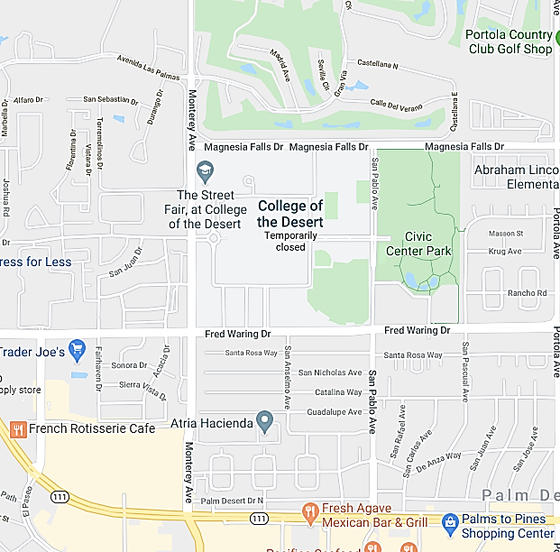

Palm Desert Campus
On Campus
Public Property

Slide 17
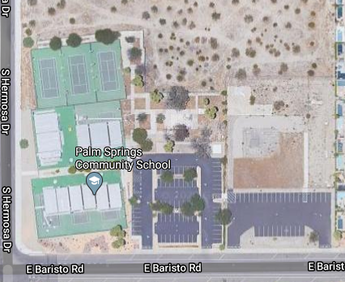
West Valley Palm Springs
Temporary Campus
On Campus
Public Property

Slide 18
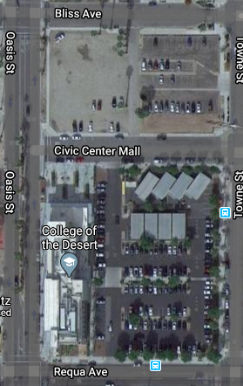
Indio
East Valley Campus
On Campus
Public Property

Slide 19
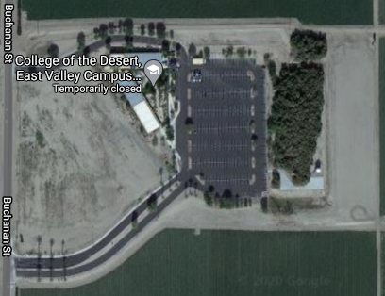
Mecca Thermal Campus
On Campus
Public Property

Slide 20
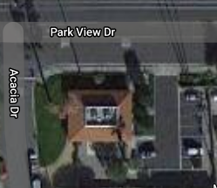
KCOD-
Palm Desert Campus
On Campus
Public Property

Slide 21
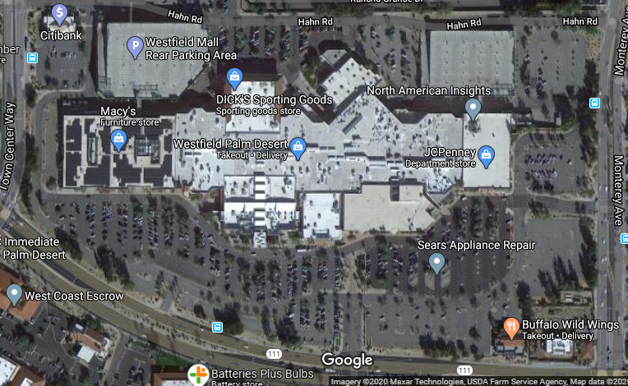
PaCE-
Westfield Mall Campus
On Campus
Public Property

Slide 22
Now that you know our Clery Geography,
what crimes must you report?
The Clery Act only requires you to report certain crimes and incidents:
FBI Uniform Crime Reporting Part 1 crimes,
(Homicide, Rape, Robbery, Aggravated Assault, Burglary, etc.)
Violence Against Women Act crimes,
(Domestic Violence, Dating Violence, Stalking)
Hate Crimes, and
Referrals for Disciplinary Action
These are referred to as “Clery Crimes”.

Slide 23
Clery Crimes
(FBI Part 1 Crimes)
Murder, Non-Negligent Manslaughter, and Manslaughter by Negligence
Sexual Assault: Any sexual act directed against another person, without consent of the victim, including instances where the victim is incapable of giving consent.
Sexual assault is divided into four subcategories:
  Rape: The penetration, no matter how slight, of the vagina or anus, with any body part or object, or oral penetration by a sex organ of another person, without the consent of the victim. This offense includes the rape of both males and females.
  Fondling: The touching of the private body parts of another person for the purpose of sexual gratification, without the consent of the victim, including instances where the victim is incapable of giving consent because of his/her age or because of his/her temporary or permanent mental incapacity.

Slide 24
Clery Crimes
(FBI Part 1 Crimes)
Sexual Assault (continued)
  Incest: Sexual intercourse between persons who are related to each other within the degrees wherein marriage is prohibited by law.
  Statutory Rape: Sexual intercourse with a person who is under the statutory age of consent.
Robbery: The taking or attempting to take anything of value from the care, custody, or control of a person or persons by force or threat of force or violence and/or by putting the victim in fear.
Aggravated Assault: An unlawful attack by one person upon another for the purpose of inflicting severe or aggravated bodily injury. This type of assault usually is accompanied by the use of a weapon or by means likely to produce death or great bodily harm.

Slide 25
Clery Crimes
(FBI Part 1 Crimes)
Burglary: The unlawful entry of a structure to commit a felony or theft.
Motor Vehicle Theft: The theft or attempted theft of a motor vehicle.
Arson: Any willful or malicious burning or attempt to burn, with or without intent to defraud, a dwelling house, public building, motor vehicle or aircraft, personal property of another, etc.
WHEN IN DOUBT, REPORT IT!
You are not expected to know all the nuances of these crime definitions.
If you are unclear or unsure how to classify a particular incident,
please contact the College of the Desert Public Safety Department.

Slide 26
Clery Crimes
(Hate Crimes)
A Hate Crime is a criminal offense that manifests evidence that the victim was intentionally selected because of the perpetrator's bias against the victim. In addition to the seven Part 1 crimes described above, the following crimes are Clery Crimes if they are hate crimes:
Larceny-Theft: The unlawful taking, carrying, leading or riding away of property from the possession or constructive possession of another.
Simple Assault: An unlawful physical attack by one person upon another where neither the offender displays a weapon, nor the victim suffers obvious severe or aggravated bodily injury involving apparent broken bones, loss of teeth, possible internal injury, severe laceration, or loss of consciousness.
WHEN IN DOUBT, REPORT IT!
If you are unclear or unsure how to classify a particular incident,
please contact the College of the Desert Public Safety Department.

Slide 27
Clery Crimes
(Hate Crimes)
Intimidation: To unlawfully place another person in reasonable fear of bodily harm through the use of threatening words/or other conduct, but without displaying a weapon or subjecting the victim to actual physical attack.
Destruction/Damage/Vandalism of Property: To willfully or maliciously destroy, damage, deface, or otherwise injure real or personal property without the consent of the owner or the person having custody or control of it.
WHEN IN DOUBT, REPORT IT!
If you are unclear or unsure how to classify a particular incident,
please contact the College of the Desert Public Safety Department.

Slide 28
Clery Crimes
(Violence Against Women Act – “VAWA”)
Domestic Violence
  A felony or misdemeanor crime of violence committed:
  by a current or former spouse or intimate partner of the victim.
  by a person with whom the victim shares a child in common.
  by a person who is cohabitating with, or has cohabitated with, the victim as a spouse or intimate partner.
  by a person similarly situated to a spouse of the victim under the domestic or family violence laws of the jurisdiction in which the crime of violence occurred;
  by any other person against an adult or youth victim who is protected from that person’s acts under the domestic or family violence laws of the jurisdiction in which the crime of violence occurred.

Slide 29
Clery Crimes
(Violence Against Women Act – “VAWA”)
Dating Violence
  Violence committed by a person who is or has been in a social relationship of a romantic or intimate nature with the victim. The existence of such a relationship shall be determined based on the reporting party’s statement and with consideration of the length of the relationship, the type of relationship, and the frequency of interaction between the persons involved in the relationship.
  For the purposes of this definition:
  dating violence includes, but is not limited to, sexual or physical abuse or the threat of such abuse.
  dating violence does not include acts covered under the definition of domestic violence.
  Note: When the reporting party asserts that there was a dating relationship, you should assume that the victim and perpetrator were in a dating relationship to avoid incorrectly omitting incidents.

Slide 30
Clery Crimes
(Violence Against Women Act – “VAWA”)
Stalking
  Engaging in a course of conduct directed at a specific person that would cause a reasonable person to:
  fear for the person’s safety or the safety of others; or
  suffer substantial emotional distress.
  Course of conduct means two or more acts, including, but not limited to, acts in which the stalker directly, indirectly, or through third parties, by any action, method, device, or means, follows, monitors, observes, surveils, threatens, or communicates to or about a person, or interferes with a person’s property.
  Reasonable person means a reasonable person under similar circumstances and with similar identities to the victim.
  Substantial emotional distress means significant mental suffering or anguish that may, but does not necessarily require medical or other professional treatment or counseling.

Slide 31
What must a CSA do when they receive a report of a crime?
If you receive a report of a Clery Crime on COD’s Clery Geography, you are required to report it to the College of the Desert Public Safety Department.
You may also be required to report an incident to the local law enforcement agency that has jurisdiction in that area and/or other officials under policies or laws concerning child abuse, sexual harassment, sexual violence, and workplace violence.
You should advise the person about your reporting requirements and other reporting options available to them. Your required CSA report to the College of the Desert Public Safety Department is not the same thing as them filing a police report with the local law enforcement agency that has jurisdiction in that area where the crime was committed.
Other reporting options include, but are not limited to:
COD Public Safety Department • Student Health Services
Director of Student Life • Human Resources

Slide 32
What must a CSA do when they receive a report of a crime?
Gather information to the extent possible:
  The nature or description of the crime or incident
  Where the crime or incident occurred
  When the crime or incident occurred
  When the crime or incident was reported to you
  The affiliation of the involved parties
The report shall be forwarded to the COD Public Safety Department “without identifying the victim, unless the victim consents to being identified after the victim has been informed of his or her right to have his or her personally identifying information withheld.” [California Education Code § 67383(b)]

Slide 33
What must a CSA do when they receive a report of a crime?
Any report of a violent crime, sexual assault, or hate crime made to a CSA must be reported to UCLA PD Clery Coordinator immediately, or as soon as practicably possible.
Rape
Homicide
Robbery
Hate Crime
Forced
Sodomy
COD
Aggravated
Assault
Rape by
Foreign Object
Forced Oral
Copulation
Sexual
Battery

Slide 34
What must a CSA do when they receive a report of a crime?
Report all Clery Crimes on COD’s Clery Geography to the College of the Desert Public Safety Department.
REMEMBER: Call 9-1-1 immediately if a crime is in progress or if an immediate threat is posed to any member of the campus community.

Slide 35
What must a CSA do when they receive a report of a crime?
Though the reporting requirements apply to the individual CSA who first learns of or witnesses the incident, some departments have made arrangements with the College of the Desert Public Safety Department to centralize the reporting of Clery Crimes occurring on COD’s Clery Geography.
Regardless of any special reporting procedures, the Clery Act, College Policy, and California law all require that College of the Desert Public Safety Department be informed immediately or as soon as practicably possible of any Clery Crime occurring on COD’s Clery Geography!

Slide 36

What must a CSA do when they receive a report of a crime?
If you are unclear or unsure about any reporting requirements or crime classifications, please contact the College of the Desert Public Safety Department.
Public Safety Dispatch
760-341-2111
Publicsafetyreports@collegeofthedesert.edu
REMEMBER: Call 9-1-1 immediately if a crime is in progress or if an immediate threat is posed to any member of the campus community.

Slide 37
Why is it important for a CSA to notify CODPSD immediately?
TIMELY WARNINGS
COD is required to issue an alert to the college campus community when a
Clery Crime occurs on our Clery Geography and it represents a
“serious or continuing threat to students and employees”.
The intent is to enable members of the campus community to protect themselves.
A warning should be issued as soon as pertinent information is available.
As soon as a CSA learns of a Clery Crime occurring on Clery Geography, “COD” knows about it and a determination must be made whether to issue a Timely Warning.
College of the Desert Public Safety Department makes those determinations, and issues the Timely Warnings.
Therefore, CODPSD must be notified immediately of all
Clery Crimes occurring on our Clery Geography.

Slide 38
Why is it important for a CSA to notify CODPSD immediately?
LOCAL LAW ENFORCEMENT AGENCY NOTIFICATION
COD is required to notify the local law enforcement agency (RSD, IPD, PSPD, DHSPD or any of the local law enforcement agencies that have jurisdiction in those areas) immediately, or as soon as practicably possible, when a CSA learns of the following Clery Crimes occurring on COD’s Clery Geography:
        • Homicide • Sexual battery
        • Rape • Robbery
        • Forced sodomy • Aggravated assault
        • Forced oral copulation • Hate crime
        • Rape by a foreign object
Therefore, CODPSD must be notified immediately of all
Clery Crimes occurring on our Clery Geography.

Slide 39
Why is it important for a CSA to notify CODPSD immediately?

Slide 40
CSA - Previous Year Submission Certification
Each year, CSAs will receive a letter from the Director of Public Safety asking them to certify that they have provided all the required CSA reports throughout the previous calendar year. CSAs must submit Clery Crime information at that time if it wasn’t previously submitted. If a CSA already submitted information about a Clery Crime (either by calling CODPSD for a police response or by submitting the Clery Incident and Disciplinary Referral Form to the UCLA PD Clery Coordinator), they do not need to resubmit information on that crime.
Statistics on Disciplinary Referrals should also be provided in response to the annual letter.
According to the Clery Act, Referred for Disciplinary Action is defined as:
The referral of any person to any official who initiates a disciplinary action of which a record is established and which may result in the imposition of a sanction.

Slide 41
Referrals for Disciplinary Action
Weapons: Carrying, Possession, Etc. Violations: The violation of laws or ordinances prohibiting the manufacture, sale, purchase, transportation, possession, concealment, or use of firearms, cutting instruments, explosives, incendiary devices or other deadly weapons. This classification encompasses weapons offenses that are regulatory in nature.
Drug Abuse Violations: The violation of laws prohibiting the production, distribution and/or use of certain controlled substances and the equipment or devices utilized in their preparation and/or use. The unlawful cultivation, manufacture, distribution, sale, purchase, use, possession, transportation or importation of any controlled drug or narcotic substance. Arrests for violations of state and local laws, specifically those relating to the unlawful possession, sale, use, growing, manufacturing and making of narcotic drugs.
Liquor Law Violations: The violation of state or local laws or ordinances prohibiting the manufacture, sale, purchase, transportation, possession or use of alcoholic beverages, not including driving under the influence and drunkenness.

Slide 42
Referrals for Disciplinary Action
Please see the additional guidance regarding Referrals for Disciplinary Action:
Do not count the number of persons who were referred for disciplinary action solely for violation of institutional policy. Only count the number of persons referred for disciplinary action based on violations of the law.
If a person is referred for disciplinary action for multiple incidents in the same calendar year (e.g., one referral in February and one referral in March), count this as two referrals for disciplinary action. It is counted as two referrals even if both referrals are for the same type of violation (e.g., both were Drug Abuse Violations).

Slide 43
Referrals for Disciplinary Action
Do Referrals for Disciplinary Action have to go through a hearing process, or does discipline need to be issued before they are eligible to be reported for Clery Act statistics?
NO!
Just like with crime reporting, referrals for disciplinary action only have to be reported or known to the CSA to be counted in the annual crime statistics report.
The CSA must report the number of Referrals for Disciplinary Action to the COD Public Safety Department in response to the annual CSA letter.

Slide 44

Who enforces the Clery Act?
The U.S. Department of Education.
The Clery Act is federal law.

Slide 45
Current Penalties For Violations of the Clery Act
The penalty for a violation of the Clery Act is currently up to $58,328 per violation, as of 2018. Violations which occurred in earlier years will be charged the penalty in effect at the time of the violation.
Complaints can be filed with the U.S. Department of Education by students, faculty, or staff if they believe an institution is not meeting the requirements of the Clery Act. Complaints may result in investigations by the U.S. Department of Education.
The U.S. Department of Education may also conduct random audits of colleges and universities to ensure they are complying with the Clery Act.
In addition to monetary fines, the U.S. Department of Education can suspend an institution’s participation in federal financial aid programs and revoke institutional accreditation if they fail to comply with the Clery Act.

Slide 46
Other Consequences of Non-Compliance
Enormous press and media coverage;
Loss of U.S. financial aid for students;
Litigation costs and fees to hire attorneys;
Resources lost due to settlements of claims;
Loss of reputation (devaluation of COD brand);
Loss of incoming students and clients;
Criminal and/or civil charges.

Slide 47
For additional information, please refer to:
The Handbook for Campus Safety and Security Reporting (2016 Edition) – U.S. Department of Education
  https://ed.gov/admins/lead/safety/handbook.pdf
College of the Desert CLERY Information– Clery Act
  http://www.collegeofthedesert.edu/students/psd/Pages/CLERY.aspx
California Education Code §§ 67380 – 67386
  https://leginfo.legislature.ca.gov/faces/codes_displaySection.xhtml?lawCode=EDC&sectionNum=67380

Slide 48

CSA Training
For more information on campus safety or to read COD’s Annual Security Report, please visit:
http://www.collegeofthedesert.edu/students/psd/Pages/CLERY.aspx
Questions? Contact College of the Desert Public Safety Department:
Director Dr. Tim T. Nakamura
760-341-2111

Slide 49
Thank you !
The information used in this training presentation was provided by the CLERY Center, College of the Desert Public Safety Department and the US Department of Education.

